Slide 1
Part 1: React and OOP: Designing Maintainable TypeScript Applications

Slide 2
Goal:
By the end of the session, you should be able to:
Define the four main OOP principles — Encapsulation, Abstraction, Inheritance, and Polymorphism
Implement these principles using TypeScript classes and interfaces.
Apply OOP concepts to React components and services for cleaner, more scalable architecture.
SOLID Principles: Writing Testable & Maintainable Code
Demonstrate how interfaces and dependency inversion improve component reusability and code maintainability in React.

Slide 3
What is OOP(Object-Oriented Programming)?
Organizes code around objects (data + behavior)
Promotes reusability, maintainability, and scalability. “ Object-Oriented Programming is a strategy that provides some principles for developing applications or software. It is a methodology ”.

Slide 4
Class
A class is a blueprint for creating objects that have data (properties) and behavior (methods).
A class defines how an object looks and behaves. It can have real implementations of methods, constructors, and data members.
A class = structure + implementation (real working code).

Slide 5
Abstract Class
An abstract class is a special kind of class that cannot be instantiated directly. It’s meant to be inherited by other classes.
An abstract class defines a base template for other classes. It can include both shared logic and rules that subclasses must follow.
It can have:
Abstract methods (no implementation, must be overridden)
Concrete methods (with real code, reusable by subclasses)

Slide 6
Interface
An interface defines the structure or contract that a class (or object) must follow. It only describes what properties or methods should exist — not how they work.
An interface is a contract that defines the shape of an object — properties and method signatures — without providing implementation.
An interface = “contract only” — tells what must exist, not how.

Slide 7
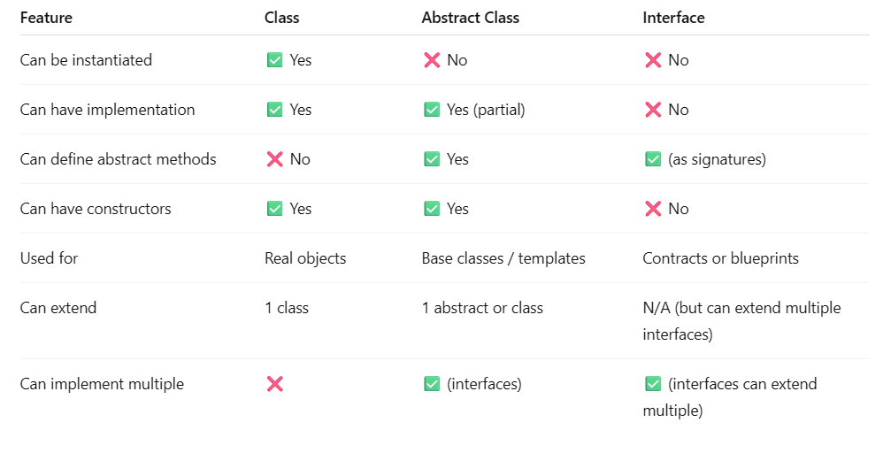

Slide 8
Function Overloading
Function overloading means having multiple versions of the same function name, but each version has a different method signature — that is, different parameter types, parameter count, or parameter order. Function overloading allows you to define multiple ways to call a function — depending on what arguments you pass.

Slide 9
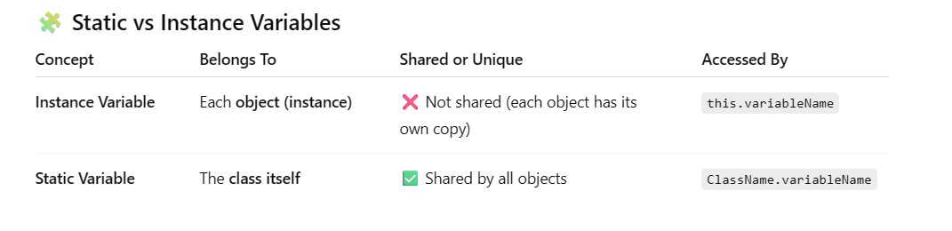
Static vs Instance Variable

Slide 10
Getter and Setter
Getter (get) = allows you to access a private property in a controlled way
Setter (get) = allows you to change a private property in a controlled way.

Slide 11
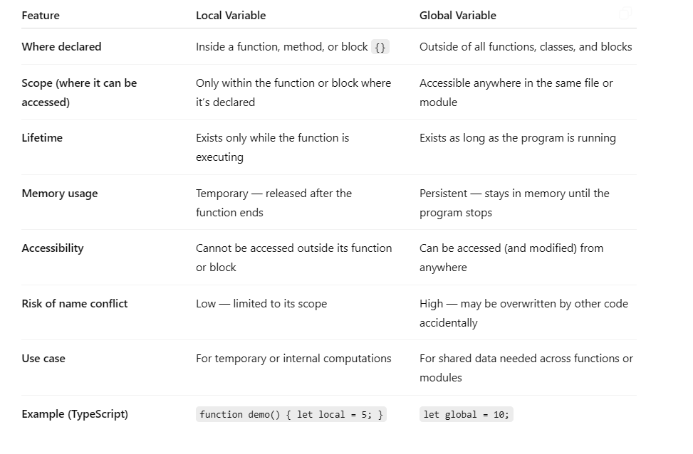
Local vs Global Variable

Slide 12
The Principles of OOP
Encapsulation
Abstraction
Inheritance
Polymorphism

Slide 13
Section 1: Encapsulation
Bundles data and behavior into one unit (the class)
Prevents direct access to internal state
Promotes modularity and security

Slide 14
Section 2: Abstraction
Hides complex logic behind a simple interface
Shows only what’s necessary to the outside world
Improves readability and reusability

Slide 15
Section 3: Inheritance
A class can inherit from another class
Child class reuses and extends parent behavior

Slide 16
Section 4: Polymorphism
Same interface, different behaviours
Allows flexibility and code reuse

Slide 17
Part 2: SOLID Principle – Design testable and maintainable code

Slide 18
S – Single Responsibility Principle
A class should have one and only one reason to change, meaning that a class should have only one job.

Slide 19
O – Open-Closed Principle
Objects or entities should be open for extension but closed for modification.

Slide 20
L – Liskov’s Substitution Principle
Derived / child classes must be substitutable for their base / parent classes

Slide 21
I – Interface Segregation Principle
Do not force any client to implement on interface which is irrelevant to them.

Slide 22
D – Dependency Inversion Principle
Classes should rely on abstractions (e.g. interfaces or abstract classes) rather than concrete implementations.

Slide 23
Questions?

